Slide 1
Group 8
World Happiness Report
Andy Lyu, Jax Luo, Shirley Yu, Morgan Zhang

Slide 2
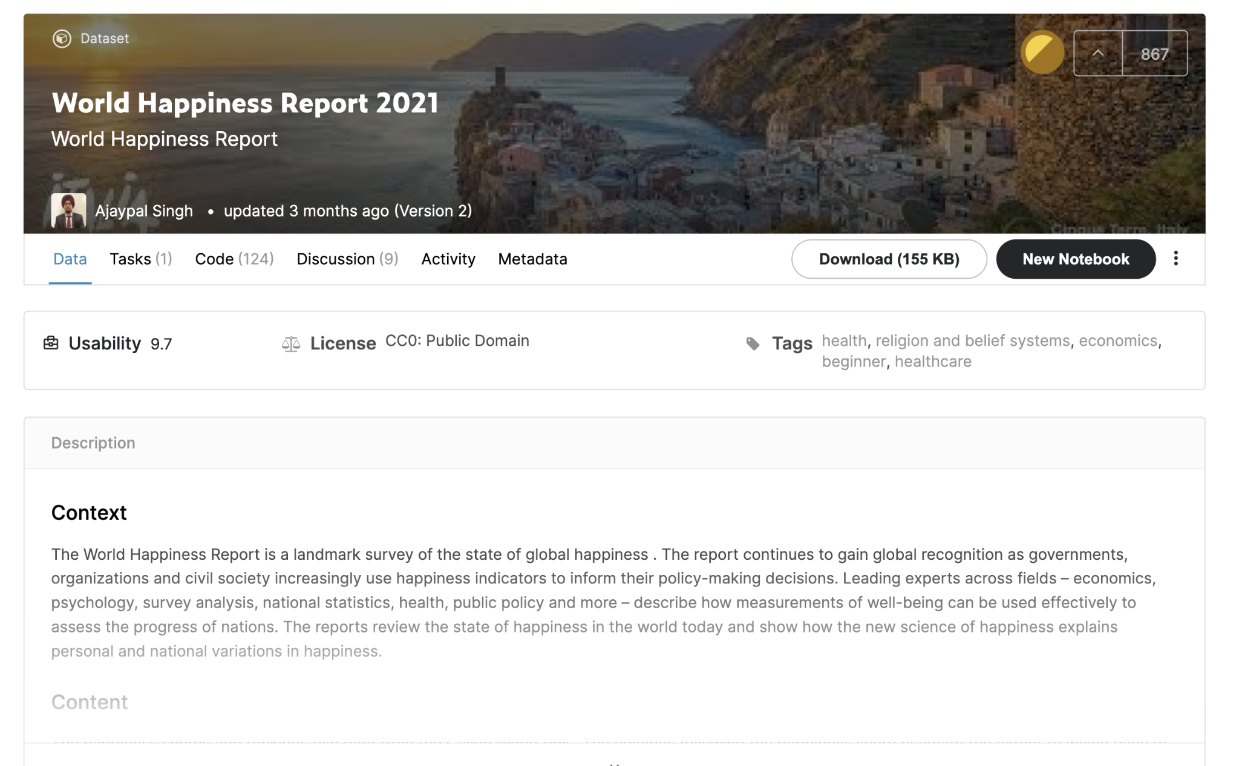
Our data
Kaggle world happiness dataset
https://www.kaggle.com/ajaypalsinghlo/world-happiness-report-2021
The happiness scores and rankings use data from the Gallup World Poll . The columns following the happiness score estimate the extent to which each of six factors – economic production, social support, life expectancy, freedom, absence of corruption, and generosity. They have no impact on the total score reported for each country, but they do explain why some countries rank higher than others.
Notes:
Note that we understand increasing those values at the same scale does not represent the same amount of resources can be put in to achieve the same results, but that is our testing methodology regardless.

Slide 3
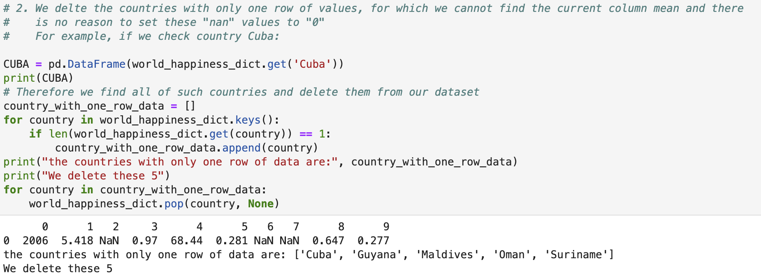
Processing Data
Notes:
80% training data 20% testing data

Slide 4
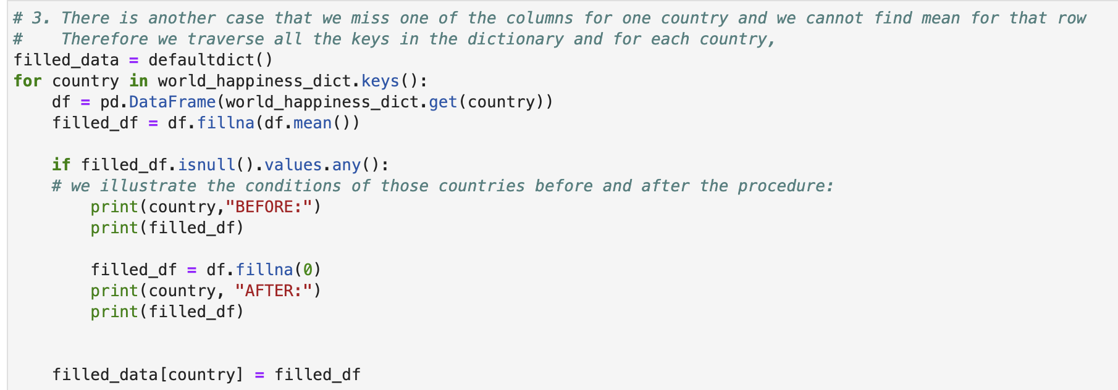
Processing Data

Slide 5
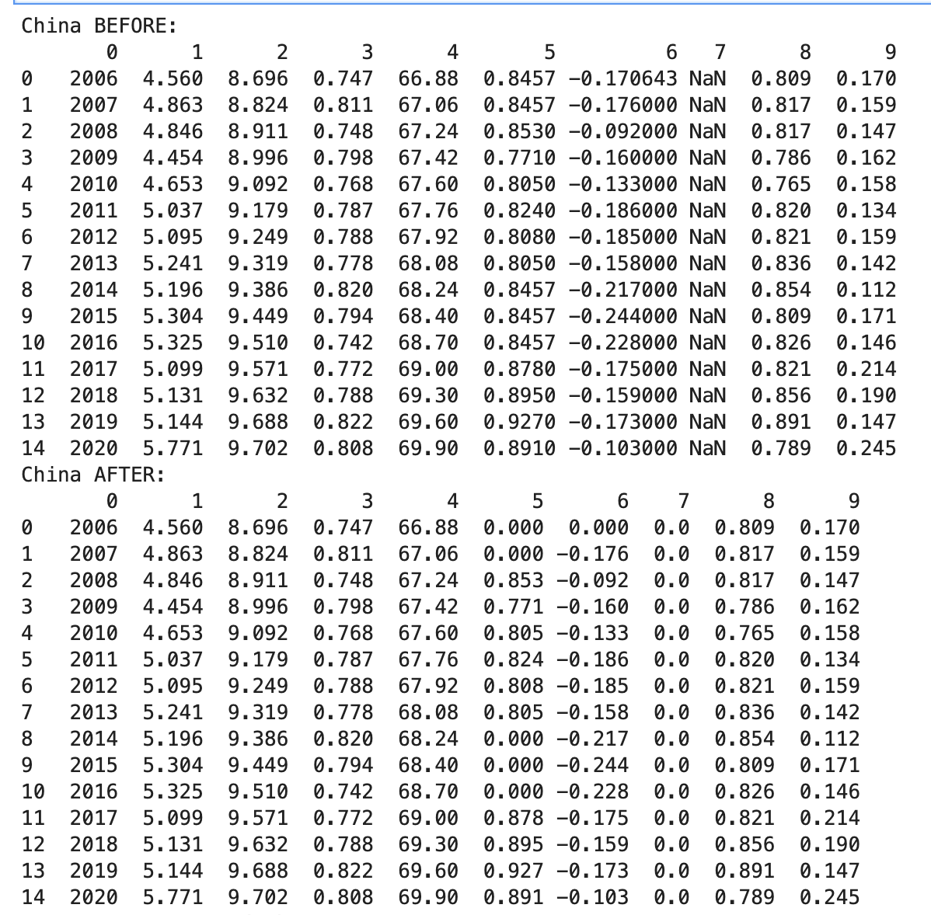

Slide 6
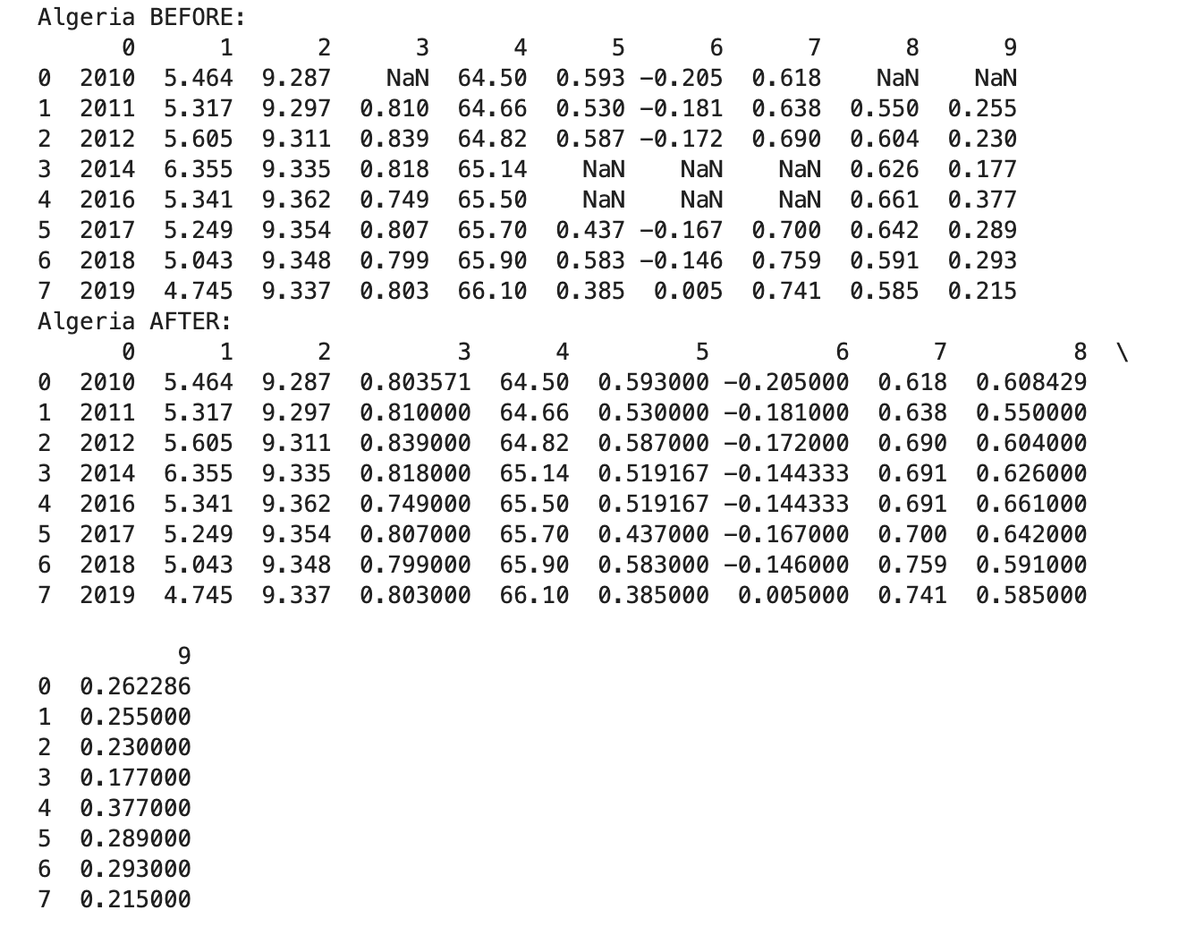

Slide 7
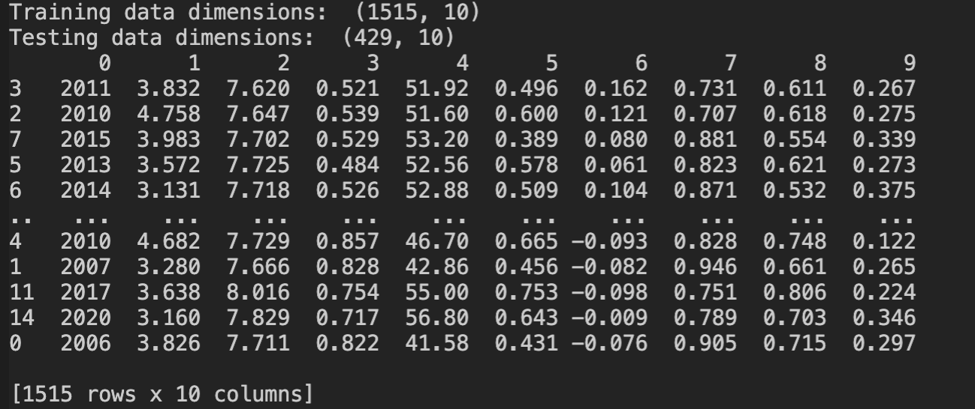
Processing Data

Slide 8
Goal
To find what the world needs to improve on the most to achieve a higher quality of life.
Create a regression model that can predict the happiness score given certain social parameters.
Explain some decisions the model took to arrive at a given conclusion.

Slide 9
Approach
A random forest regressor trained on the world happiness dataset provided via Kaggle
Why random forest?
We combine the low bias and high variance trait of decision trees, merge a “forest” of trees to arrive at a more desired outcome.
Through visualizing each individual decision tree, we can somewhat reason why the model decided on the decision that was outputted.
Elevate each individual parameter by a percentage and seeing how much that would impact the happiness prediction outcome.
Take the maximum happiness that is achieved through raising all parameters by the same scale factor.
Why not use linear regression?
The human mind returns to equilibrium
Infinite money does not correlate with infinite happiness
Notes:
Nonlinear:
10 dollars in a needy family
1 million for a billionaire

Slide 10
Methodology
Random forests are an ensemble learning method for classification, regression and other tasks that operates by constructing a multitude of decision trees at training time.
What is the decision tree?
A decision tree is a decision support tool that uses a tree-like model of decisions and their possible consequences, including chance event outcomes, resource costs, and utility.
Decision trees has low bias and high variance, the tradeoff depending on the depth of the tree and how it splits.
Low bias high variance means each tree fits its training model too well, causing overfitting and learning the noise associated with the dataset.

Slide 11
Methodology
Why the name ‘random forest?’
Each decision tree in the forest considers a random subset of features when forming questions and only has access to a random set of the training data points.
The diversity in the forest leads to more robust overall predictions and the name ‘random forest.’
A random forest regressor aggregates each tree decision and takes an average
Notes:
Why 300 trees: accuracy will not increase more given more trees which means more cost

Slide 12
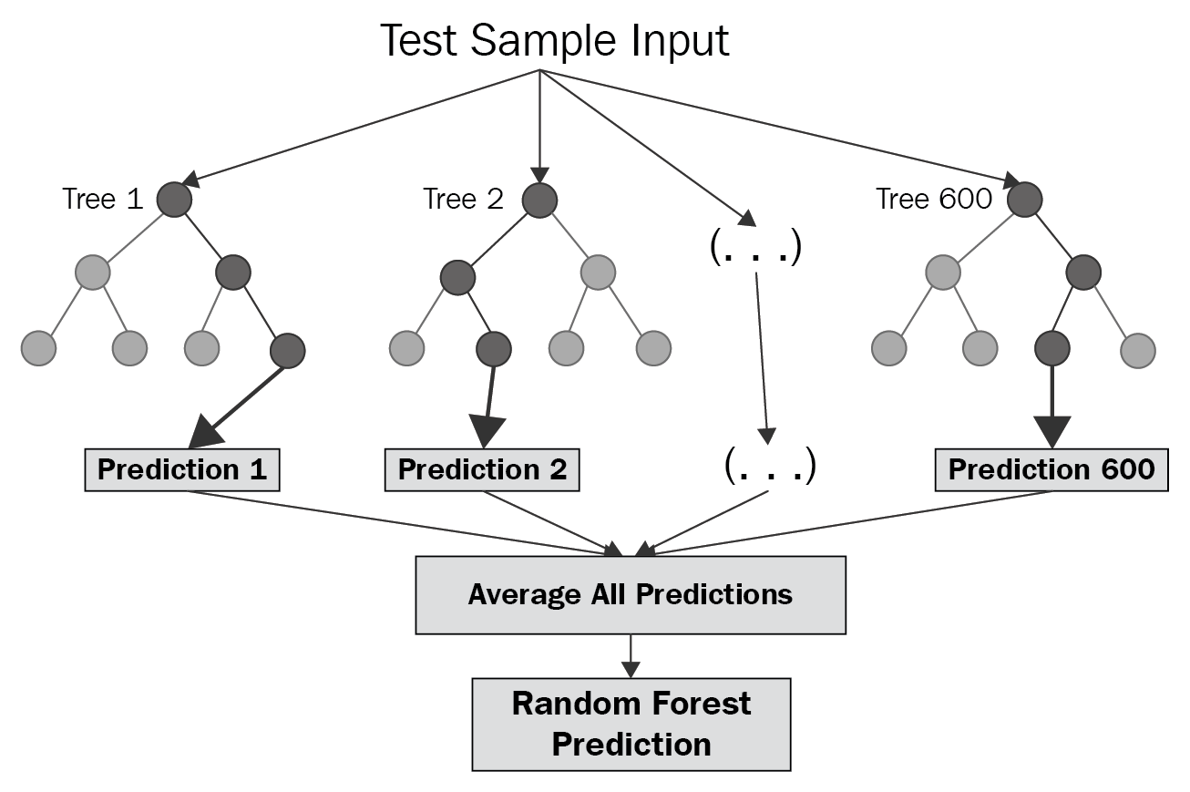
Methodology

Slide 13
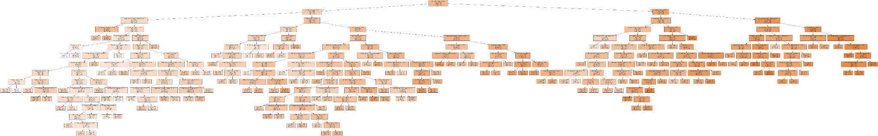
Implementation
To arrive at an estimate, we
set a series of questions to narrow possible values until reaching a single prediction.
repeat this decision process over and over again.
Optimal testing reveals 300 trees, each with 150 nodes max per tree
For example, here is a single tree in our model random forest visualized:

Slide 14
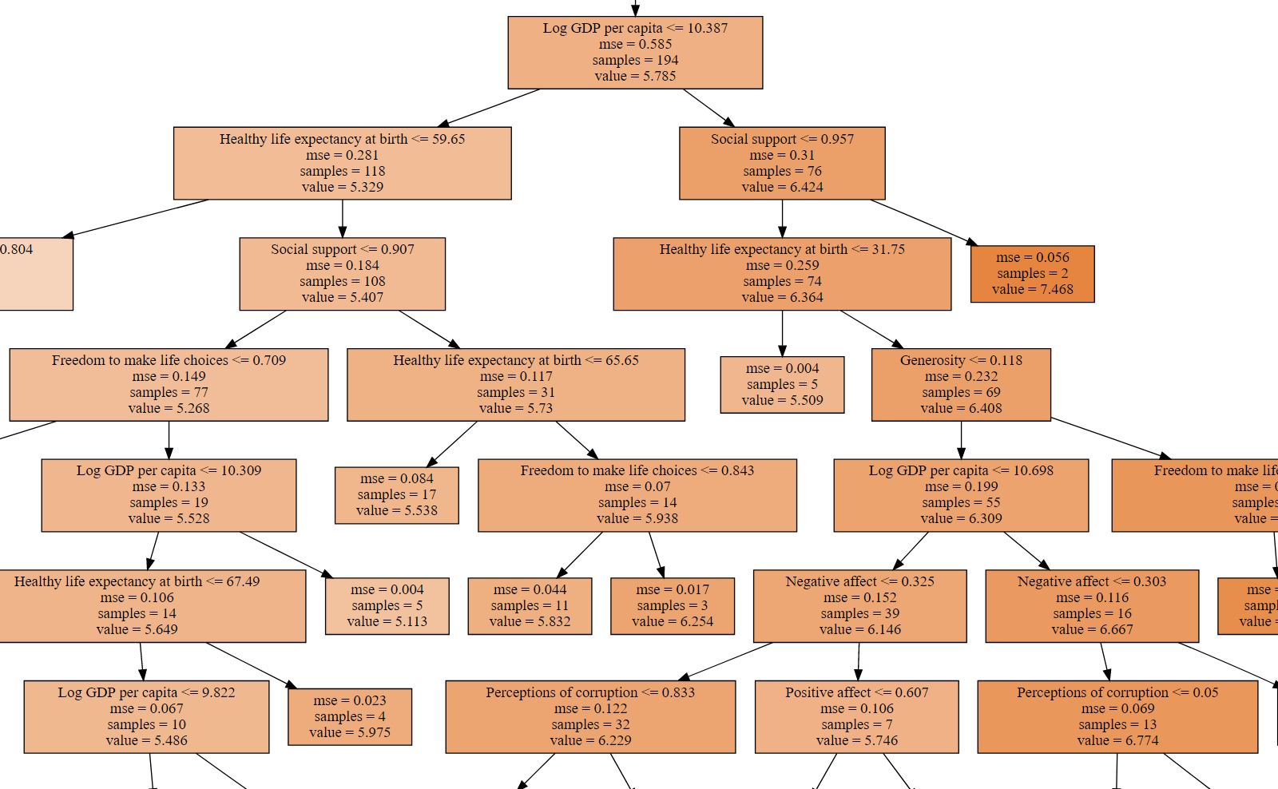

Slide 15
Results
Average difference on testing set: 3%
Average of (abs(predicted_y - actual_y) / actual_y)
Coefficient of determination R² (forest score): 0.84
Better accuracy the closer it is to 1
R² = (1 - u/v)
u defined as the residual sum of squares ((y_true - y_pred) ** 2).sum()
v defined as the total sum of squares ((y_true - y_true.mean()) ** 2).sum()
Notes:
Take the average loss of the regressor and yield a pretty good answer.

Slide 16
Results
Feature best to improve the world with 1% scale up:
Social support
Feature best to improve the world with 10%, 50%, and 100% scale up:
Log GDP per Capita
Feature scaling needed to improve world happiness by 5%:
Log GDP per Capita : 6%
Social Support : 8%
Healthy life expectancy at birth: : 7%
All other features : undetermined (will be explained later as a part of limitations)
Notes:
1%,10%,50%,100%增加相对比

Slide 17
Limitations
Regressor outputs limited by the upper and lower bound of the given training data
Acceptable for our purpose because we want to find realistic improvements the world need to make in order to achieve better happiness (i.e. what we need to improve to reach Finland levels)
Cannot miss out on features
If you disregard the individual decision trees that rely on the features which are missing, it is possible to arrive at a prediction however the result may be highly inaccurate.

Slide 18
Questions?

Slide 19
Thank you :)

